Slide 1
Crack Cocaine and Synthetic Drugs: Clinical, Psychobiological and Sociological Realities. Implications for Treatment
Ricardo Restrepo, MD; MPH
The Addiction Institute of NY
St. Luke’s-Roosevelt Hospitals
VI Simpósio Internacional de Alcoologia e Outras Drogas
Vila Serena Bahia-Brasil
Salvador, Bahia, 28 e 29 de Outubro de 2011

Slide 2
Outline
Introduction (History and Understanding Production Steps)
Epidemiology
Neurobiology of Stimulants and the Rewarding System
Clinical Picture and Signs
Intoxication and Withdrawal
Prevention and Treatment approach
Conclusions

Slide 3
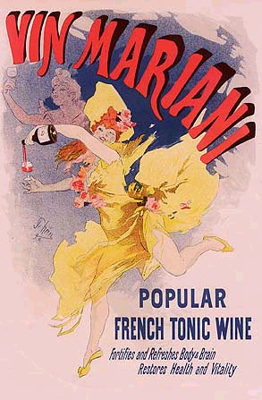
A Brief History of Cocaine
3000 B.C. – Coca leaf chewing and coca tea
1855 - Cocaine was extracted from the leaves of the coca plant (Erythroxylon coca) by Gaedcke
1860 – Cocaine isolated from the coca plant by Albert Neiman
1884- Freud published Über Coca
1903- Coca-Cola stopped using coca leaves in their product
1914 – Harrison Narcotic Act
1930s – Benzedrine inhaler
1970- the Controlled Substances Act officially made cocaine illegal in the United States as a Schedule II drug
1980s – Crack
Notes:
Vin Mariani – 6-8 mg cocaine per ounce

Slide 4
Crack/Paco Production Step 1

Slide 5
An addict sells individual doses of PBC so that s/he can afford to consume it herself. For about R$2, users can buy enough of this type of cocaine for a 15-minute high.

Slide 6
Crack/Paco Production Step 2
Cocaine Base (PBC)----Paco/bazuco/pitillo-smoked/smoked with tobacco
+ potassium permanganate + sodium bicarbonate
+ sulphuric/hydrochloric acid +acid/acetone
+ ammonia +ether/ethanol
Cocaine Base “washed paste”----Paco/bazuco/pitillo-smoked/smoked with tobacco
Cocaine Base Paste (PBC)----Paco/bazuco/pitillo-smoked/smoked with tobacco
Crack/merla
Smoked/inhaled
Cocaine base “washed paste”---Paco/bazuco/pitillo-smoked/smoked with tobacco
Notes:
Smokeable cocaine on the basis of cocaine base paste with similar effects as crack is quite popular. It is called merla or mescla , mela , mel , melado and is made from cocaine base paste, barrilha or sodium carbonate (also known as washing soda or soda ash -Na2 CO3 ) and battery acid (sulphuric acid -H2SO4) or boric acid (H3BO3 – often used as an antiseptic and insecticide) to dissolve the cocaine base paste.

Slide 7
Crack/Paco Production steps
Step 1 (left): Dissolving powder cocaine in hot water Step 2 (right): Adding sodium bicarbonate to the mixture
Photo courtesy: U.S. Drug Enforcement Administration

Slide 8
Crack/Paco Production steps
Step 3 (left): Boiling the solution to separate out the solids Step 4 (right): Cooling the separated mixture

Slide 9
Crack/Paco Production Step 3
Cocaine Base (PBC)----Paco/bazuco/pitillo-smoked/smoked with tobacco
+ hydrochloric acid
+ acetone/ether
+ potassium permanganate
Cocaine Base “washed paste”----Paco/bazuco/pitillo-
+ammonia/sodium bicarbonate Crack---smoked/inhaled
Cocaine Base “washed paste”----Paco/bazuco/pitillo-smoked/smoked with tobacco
Residue---Paco/smoked
Cocaine hydrochloride---snorted/injected
Crack---
smoked/inhaled
Notes:
Knowing what is being consumed is crucial not only for investigating harm associated with PBC consumption, but also for trying to explain the emergence of this new pattern of drug consumption.

Slide 10
Crack/Paco Production steps
Step 5: Filtering the cooled mixture to isolate the solids

Slide 11
Crack/Paco Production final step
Crack cocaine

Slide 12
Epidemiological data
The cocaine epidemic in the United states peaked in 1985.
1.4 million current cocaine users in 2008
35 million had used cocaine in their lifetimes in The United States (8.6 million crack-cocaine)
The 2006 NSDUH (National Survey on Drug Use and Health)
14.3 million cocaine users worldwide in 2005
half (44%)-6.4 million in North America
(0.8%)-2.2 million users in Latin America
The apparent link between increase in PBC consumption and poverty has been reported before in United States and Brazil (Duailib LB, Ribeiro M, Laranjeira R. Profile of cocaine and crack users in Brazil. Cad Saude Publica. 2008;24(supl 4):545-57).
U.S data: In 2007, cocaine accounted for about 13 % of all admissions to drug abuse treatment programs. The majority of individuals (72 % in 2007) who seek treatment for cocaine abuse smoke crack and are likely to be polydrug abusers, or users of more than one substance.

Slide 13
Epidemiological data and other information
With the exception of behavioral strategies, there are presently no efficacious treatment for cocaine dependence (Vocci and Montoya 2009)
Stimulant abuse and dependence as diagnostic distinctions will be eliminated in DSM-5 but the presence of three of the seven dependence syndrome criteria will remain to dx dependence (tolerance and withdrawal)

Slide 14
Cocaine Methods of Use
Route | Onset | Peak | Duration
Inhalation(smoked) | 3-5 sec | 1-3 min | 5-15 min
Intravenous | 10-60 sec | 4-7 min | 20-60 min
Intranasal or other mucosal | 1-5 min | 15-20 min | 60-90 min
What is the chemical formed when cocaine and alcohol are combined?
Cocaethylene
Powerful vasconstrictor and stimulant
Why is it so reinforcing?
Longer acting, more intense stimulus, may affect development of tolerance for alcohol and cocaine
Why combine heroin and cocaine (speedball)? Or oxycodone and methamphetamine?
Stimulant will stave off the sleepiness “nodding” from opiates
Opiates will decrease the irritability of stimulant toxicity

Slide 15
Neurobiology of Stimulants
All cause release or block reuptake of neurotransmitters
Dopamine: cocaine in particular
Mimic NE by direct effect
Serotonin at high levels
NMDA, Acetylcholine, substance P, endogenous opioids, GABA
Alter blood flow in prefrontal, frontal, temporal, subcortical grey areas
Dopamine effects
Increase in activity in mesolimbic and mesocortical area
NO Dopamine Transporter=No activity of stimulants

Slide 16
Cocaine in the brain
NIDA 2011
Notes:
dopamine, a brain chemical that plays important roles in the control of normal movement, and in pleasure, reward and motivation, also plays a central role in substance abuse and addiction.

Slide 17
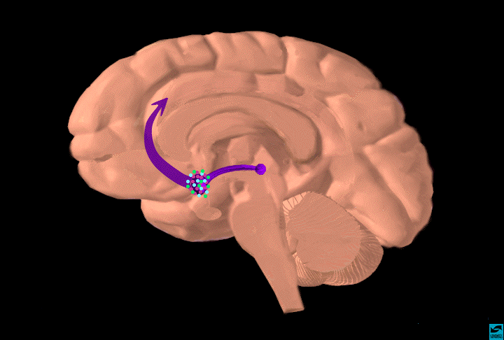
Dopamine Pathways
striatum
frontal
cortex
hippocampus
substantia
nigra/VTA
Functions
reward (motivation)
pleasure,euphoria
motor function
(fine tuning)
compulsion
perseveration
decision making
Serotonin Pathways
nucleus
accumbens
Functions
mood
memory
processing
sleep
cognition
raphe
Notes:
Dopamine and Serotonin Pathways

Slide 18
Neurotransmitter/Modulator Relationships in Reinforcement
Adapted from Kalivas and Volkow (2005) Am J Psychiatry 162:1403-1413
Notes:
Neurotransmitter/Modulator Relationships and alcohol Reinforcement:
This schematic illustrates some of the major circuits and neurotransmitter/modulator relationships in the mesolimbic reward circuit. The focus of this model is on the so-called “dopamine (DA) neuron” in the Ventral Tegmental Area (VTA), which sends dopaminergic efferent fibers to nucleus accumbens (nACC), as well as other structures implicated in reward/reinforcement (prefrontal cortex, amygdala, olfactory tubercle, lateral septal nucleus, hippocampus). The nACC target cells of the DA output are GABAergic medium spiny neurons. Firing of the DA neurons and release of DA are believed to be instrumental in reinforcing properties of alcohol and other drugs of abuse.
Ethanol stimulates enhanced firing of DA cells, an effect that derives partly from direct actions on ion channels of the DA cell itself (probably potassium and calcium channels), as well as actions on a variety of neurotransmitters and receptors in the overall circuit.
Excitatory input to the VTA is mediated by glutamate, which acts on AMPA receptors and NMDA receptors on DA neurons. The glutamatergic presynaptic terminals are themselves affected by other modulators such as acetylcholine and perhaps serotonin. This glutamate input may be particularly important to burst firing and to learning (LTP).
GABAergic inhibitory cells are key components of the VTA-nACC circuit, providing both recurrent and local inhibitory influences on the DA cell. GABAergic cells control overall basal activity of DA cells and bursting patterns of activity which are especially effective in DA release.
Serotonin input to the VTA affects multiple receptor subtypes, localized on DA cell bodies as well as on presynaptic terminals of other inputs. By itself, serotonin has little effect on DA cell firing. However, it considerably enhances the ability of ethanol to stimulate DA cell firing.
Opioid receptors impinging on GABAergic neurons in VTA are thought to mediate disinhibition of the DA cell, thereby increasing firing rate and enhancing DA release.
Cholinergic inputs from pedunculopontine tegmental nucleus (PPTg) and lateral dorsal tegmental nucleus (LDTg) stimulate DA cells directly through nicotinic cholinergic receptors (nAChR). Nicotinic input also stimulates inhibitory GABAergic cells. nAChR localized on preynaptic terminals of glutamatergic terminals from prefrontal cortex comprise an excitatory neuromodulatory influence on DA cells.
Sites of action of nicotine (nicotinic cholinergic receptors):
VTA neurons express a variety of nAChR subtypes which, when activated by nicotine, promote a sustained increase in dopamine release in nAcc that is considered pivotal to the development of nicotine addiction (Wonacott, 2005). In VTA, non-alpha7 nAChRs – probably alpha4beta2 -- have been identified on dopaminergic and GABAergic neurons. Alpha7 appear to reside on glutamatergic afferents projecting to the VTA, although they seem to be localized perisynaptically.
Systemic injection of nicotine, or direct application of nicotine into the VTA or nAcc, stimulates release of dopamine in the nAcc as measured by microdialysis. DA is preferentially released during burst firing of VTA cells rather than firing of single spikes. Burst firing may be mediated by NMDA receptors on DA cell bodies. Antagonism of NMDA receptors diminishes DA release in nAcc. Alpha7 receptors have been implicated in burst firing, and they can participate in plastic changes that enhance synaptic efficacy in VTA. The sustained elevation of DA for 60-120 min after a single injection of nicotine is characteristic of the first response. Subsequent injections of the drug in this time frame have little further effect. Repetitive daily injections of nicotine in rats cause increased dopamine release, ie, a sensitized response. This occurs in the nAcc core but not the shell. Initial release in drug naïve rats occurs primarily in the shell.
A scheme for nicotine and nAChR influences on DA cells has been proposed by Mansvelder et al (2002). Under control conditions, alpha4beta2 nAChR can excite DA and GABA neurons directly, while alpha7 receptors can enhance release from glutamatergic terminals. Endogenous Ach release from brainstem cholinergic neurons contributes to the GABAergic tone onto VTA DA neurons. In the presence of nicotine, at smokers’ blood levels, the non-alpha7 receptors desensitize rapidly, effectively reducing GABAergic input to the DA neurons. The alpha7 receptors will not desensitize as much, which means that the glutamatergic inputs will be enhanced as the GABAergic inputs are depressed. This leads to net increase in excitation of DA neurons.
Alcohol dramatically enhances currents through nAChR that are probably of alpha4-beta2 subunit composition (Aistrup et al, 1999). Conversely, alcohol mildly inhibits currents through receptors that are probably alpha7 type.
References:
GL Aistrup, W Marszalec, T Narahashi. Ethanol Modulation of Nicotinic Acetylcholine Receptor Currents in Cultured Cortical Neurons. Molecular Pharmacology, Vol. 55, Issue 1, 39-49 (1999 ).
SB Appel, WJ McBride, M Diana, I Diamond, A Bonci, M Brodie. Ethanol effects on dopaminergic “reward” neurons in the ventral tegmental area and the mesolimbic pathway. Alcohol Clin Exper Res, 28(11):1768-1778 (2004).
HD Mansvelder and DS Mc Gehee. Cellular and synaptic mechanisms of nicotine addiction. Int J Neurobiol 53:606-617 (2002)
Vol. 55, Issue 1, 39-49, January 1999
S Wonnacott, N Sidhpura, and D Balfour. Nicotine: from molecular mechanisms to behavior. Current Opinion in Pharmacology, 5:53-59 (2005).
[Slide prepared by Dennis Twombly, Division of Neuroscience & Behavior]

Slide 19
Clinical Picture and Signs
Restless, hyperalert state
Anxiety
Irritability
Aggressive
Paranoia
Hallucinations
Depression
Fatigue
Tracks, skin abscesses
Worn down teeth
Nasal ulcerations
Dilated pupils
Increased Heart Rate
Dry Mouth
Increased reflexes
Elevated temperature
Hypertension
Sweating
Track marks, skin abscess, scarring

Slide 20
Intoxication and Withdrawal
Psychiatric: Violence, psychosis, anxiety, hallucinations
CNS: increased HR, BP, temp, euphoria, irritable, decreased need for sleep, food, sexual prowess
Cardiovascular Effects: Arrhythmias (direct and catecholamine release)
Low dose: lower HR through vagal nerve
High dose: vasoconstriction and hypertension
Pulmonary Effects: black sputum from hemorrhage secondary to vasoconstriction
Physiological: Decreased levels of prolactin, undetermined results of decreased dopamine, changes in EKG
Psychological: Moodiness, irritability, anhedonia, depression, agitation
Chronic: Exhaustion, rebound appetite, increased need for sleep
Craving: “Crash” intense with intense craving and cocaine seeking behavior ( 9h-weeks)

Slide 21
Abstinence vs. Harm Reduction
Harm Reduction: In July 2005, the Ministry of Public Health issued decree 1028 that formalized harm reduction policies in Brazil.
Needs systematic documentation
Since 1993-94 harm reduction strategies have been established in most areas of Brazil.
For crack users other strategies are needed. When sharing homemade pipes or cachimbos – which is often part of the ritual of crack usage – crack users get wounds on lips and gums and are susceptible to diseases such as herpes, tuberculoses, hepatitis and the HIV/AIDS virus. Crack use often also implicates risky sexual behaviour in exchange for crack or as a means to earn some money to buy crack.
Among some groups of sex workers, crack use is often high.
Harm reduction workers dispense condoms, pipes, pipe stems, tissues, vaseline and lip balm to counter infections and sexually transmitted diseases (STDs), as well as providing information on how to prevent unsafe crack smoking habits.

Slide 22
Impact of Cocaine Addiction
Biological changes in the brain
Physical changes particularly due to diminished nutrition, improper sleep, and limited exercise
Social isolation or change in former social activities to those activities that focus on acquiring and using cocaine; no longer is the person involved in community, cultural, or healthy activities.
Familial changes predominantly because the addict does not want to have anyone close to them acknowledge their addiction, or interfere with their drug use.
Financial factors because of the need to allocate so much money to getting cocaine, or as a result of a person losing their job because their cocaine addiction has caused diminished performance.
Spiritual changes due to isolation as well as no longer attending to their spiritual needs

Slide 23
Treatment for Cocaine Addiction
Because a cocaine treatment program needs to assess the psychobiological, social, and pharmacological aspects of the addiction, it is critical to match the best treatment regimen to the needs of the person.
Addiction treatment may consist of the following:
MI (Motivational Interviewing), which capitalizes on the readiness of individuals to change their behavior and enter treatment and can be integrated with:
Motivational incentives-CM (Contingency Management), which uses positive reinforcement to encourage abstinence from drugs.
CBT (Cognitive Behavioral Therapy), which seeks to help patients recognize, avoid, and cope with the situations in which they are most likely to abuse drugs (e.g. Matrix IOP).
Group Counseling
Community-based recovery groups 12-step workshops
Residential programs or Therapeutic communities (TCs)
Relapse prevention training

Slide 24
Pharmacological Treatment for Cocaine Addiction
Medication Approaches No medications currently are available to specifically treat cocaine addiction.
Cost of medication development and lack of interest by the pharmaceutical industry have been the main impediments.
Promise: topiramate,vigabatrin, tiagabine (mood stabilizer- GABA)), modafinil (dopamine agonist-DA), disulfiram (enzyme inhibitor-DA and NE)
Among these, disulfiram (used to treat alcoholism) has produced the most consistent reductions in cocaine abuse.
Other targeting: excitatory (glutamate) and inhibitory (gamma-aminobutyric acid) neurotransmission. Also, dopamine D3 receptors (a subtype of dopamine receptor) constitute a novel molecular target of high interest
Cocaine vaccine
Notes:
Reduce use of cocaine in clinical trials

Slide 25
CLUB DRUGS
Outline
Basic Elements
Ecstasy
Ketamine
GHB

Slide 26
Basic Elements
Effects
Neurobiology and Chemistry
Intoxication
Withdrawal
Long-Term Features

Slide 27
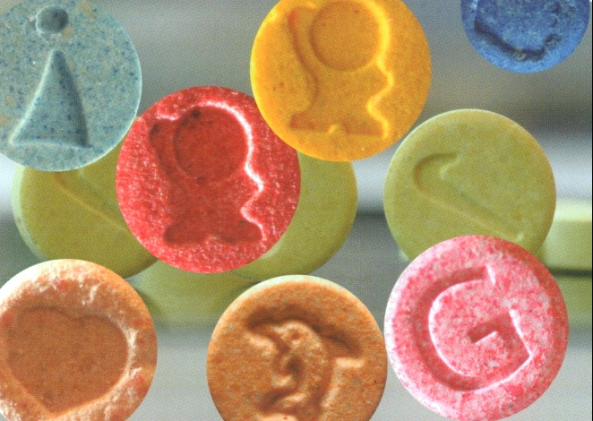
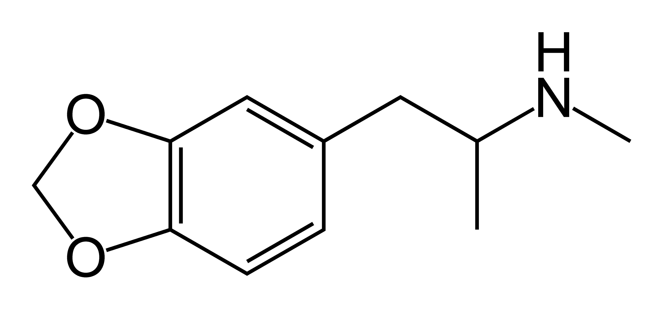
Ecstasy Methylene-Dioxy-Meth-Amphetamine

Slide 28
Effects
Essentially partly a stimulant and partly a hallucinogen:
An attenuated form of cocaine, plus
An attenuated form of LSD.
Empathy (more than ecstasy).
Profound feelings or relatedness to the rest of the world.
In the 1970s, it was used in psychotherapy (unsuccessfully).

Slide 29
Neurobiology
Acutely increases serotonin levels by:
Blocking reuptake, and
Directly releasing the neurotransmitter.
Chronically decreases serotonin levels by:
Depleting serotonin stores
Inhibiting the synthesis of new serotonin.
Neurotoxicity.

Slide 30
Intoxication
“Disco dump” and bruxism.
Stimulant effects:
Wakefulness, endurance, energy.
Trismus, anorexia, diaphoresis, hot flashes.
Serotonin Syndrome:
Treat with hydration, cooling, and sedation.
Do not use beta-blockers, which may worsen vasospasm and hypertension.

Slide 31
Withdrawal
Anhedonia and depressed mood.
Lethargy and fatigue for several days.
Frank suicidality in the absence of co-occurring depressive disorder is rare.
No indication for treatment.

Slide 32
Long-term Effects
Associated with:
Depression
Anxiety
Panic Disorder
Increased impulsivity
Sleep disturbances
Cognitive dysfunction
No FDA approved medications.
MET and CBT are the major treatment modalities.

Slide 33
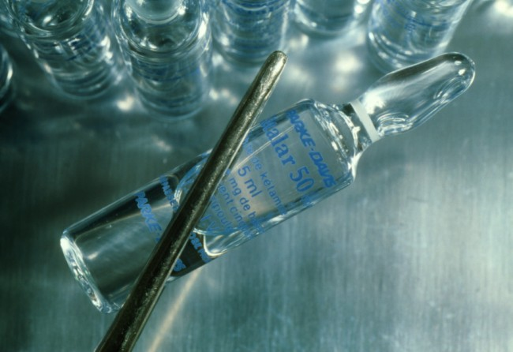
Ketamine
“A K-hole can be anything from
going to hell and meeting Satan to
going to heaven and meeting God.”

Slide 34
Effects
Similar to phencyclidine but less potent, with shorter duration.
Distorted perception of the body, the environment, and time.
Lack of responsive awareness to pain and the general environment, disconnection.
Used to achieve “higher” forms of consciousness.
Heightened capacity to discern causal connections in all things.

Slide 35
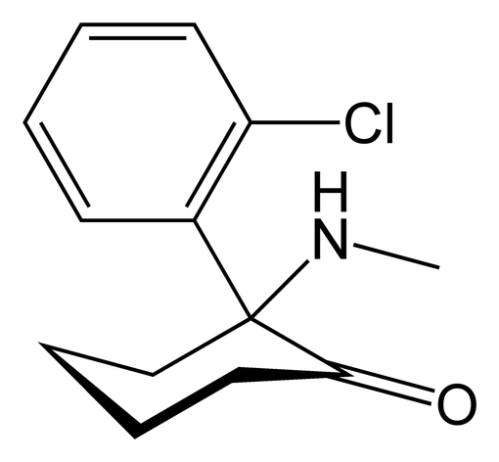
Neurobiology
Non-analgesic dissociative anesthetic used in children and animals.
Non-competitive NMDA antagonist.
NMDA inhibition is related to:
Schizotypal symptoms
Dissociative symptoms

Slide 36
Intoxication
Mild doses:
Autistic stare (“sightless staring”)
Paucity of thinking
Higher doses:
K-hole (zombie-like state), accidents
Overdose is very rare (LD₅₀ is approximately 60 times the recreational dose).
Treat with calm reassurance and low-stimulation environment; avoid antipsychotics.

Slide 37
Withdrawal
Both the anesthetic and behavioral effects remit soon after administration.
No indication for treatment.

Slide 38
Long Term Features
Tolerance.
Long-lasting memory impairments among frequent users.
Flashbacks have been reported.
No FDA approved medications.
MET and CBT are the major treatment modalities.

Slide 39
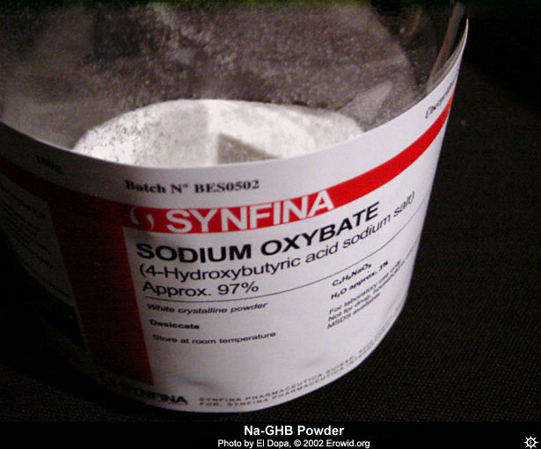
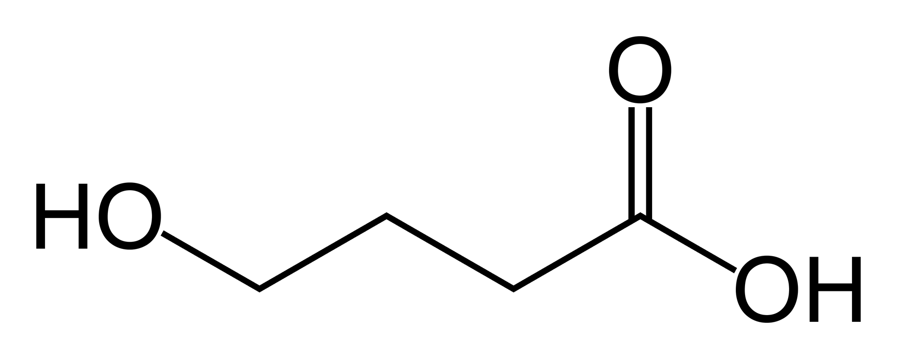
GHB Gamma-Hydroxy-Butyrate
“When I wake up, I feel completely refreshed;
in comparison to the other drugs that are supposed to be ‘clean,’G really is clean.”

Slide 40
Effects
Sensual drug, like MDMA, but also resulting in “the greatest sex ever.”
Relaxation, tranquility, placidity, mild euphoria, disinhibition.
Temporary amnesia (hence “the date rape drug”).

Slide 41
Intoxication
Steep dose-response curve:
Ataxia, loss of coordination.
Respiratory depression, bradycardia.
Coma, persistent vegetative states, death
Overdose is a real danger (LD₅₀ is only 5 times the recreational dose).
Synergistic effect with alcohol/other sedatives.
Treat as a medical emergency:
ABCs, consider Intensive Care Unit admission.
Atropine for bradycardia.
Notes:
GHB has a very steep dose-response curve, meaning that there is only a small difference between the amount required to provide the desired effect and an overdose. Also, the same dose may affect different people in different ways.

Slide 42
Withdrawal
Withdrawal is rare but severe.
Mild withdrawal may persist for several weeks after cessation of use:
Anxiety, tremor, insomnia.
“Feelings of doom.”
Severe withdrawal resembles barbiturate withdrawal:
Treat with benzodiazepines.

Slide 43
Long Term Features
Physiological dependence.
Most patients who overdose on GHB recover completely.
No FDA approved medications.
MET and CBT are the major treatment modalities.

Slide 44
Neurobiology
GHB is a neurotransmitter.
It is both a precursor and a metabolite of GABA.
Activity on both the GABA and the GHB binding sites, results in:
Temporary suppression of dopamine,
Subsequent marked release of dopamine, and
Increased release of endogenous opioids.
Also it is a highly regulated Schedule III medication for narcolepsy (Xyrem).

Slide 45
Club Drugs (Brief summary)
 | + | -
X | Emphaty | Serotonin Disruption
K | Dissociation | Accidents
G | Sex | Death

Slide 46
Conclusions
Harm Reduction techniques may decrease disease transmission, reduce crime, decrease overall mortality and morbidity, and result in reduced health care costs associated with drug use
Treatment of crack-cocaine and club drugs requires a comprehensive assessment of the patient’s psychological, medical, forensic and drug use history
Counseling (individual and/or group) and other behavioral therapies are critical components of effective treatment
Medications are important elements to be considered for the treatment of patients with crack cocaine and club drugs combined with counseling and other behavioral therapies

Slide 47
Resources
Center for Substance Abuse Treatment: Matrix intensive outpatient treatment for people with stimulant use disorders http://www.oas.samhsa.gov/matrixStimulantHandbook/family.pdf
National Institute on Drug Abuse (NIDA): www.nida.nih.gov/nidahome.html
NIDA on Club Drugs: http://www.clubdrugs.org/

Slide 48
THANKS! Gracias! Obrigado!
Questions? Comments

